Slide 1
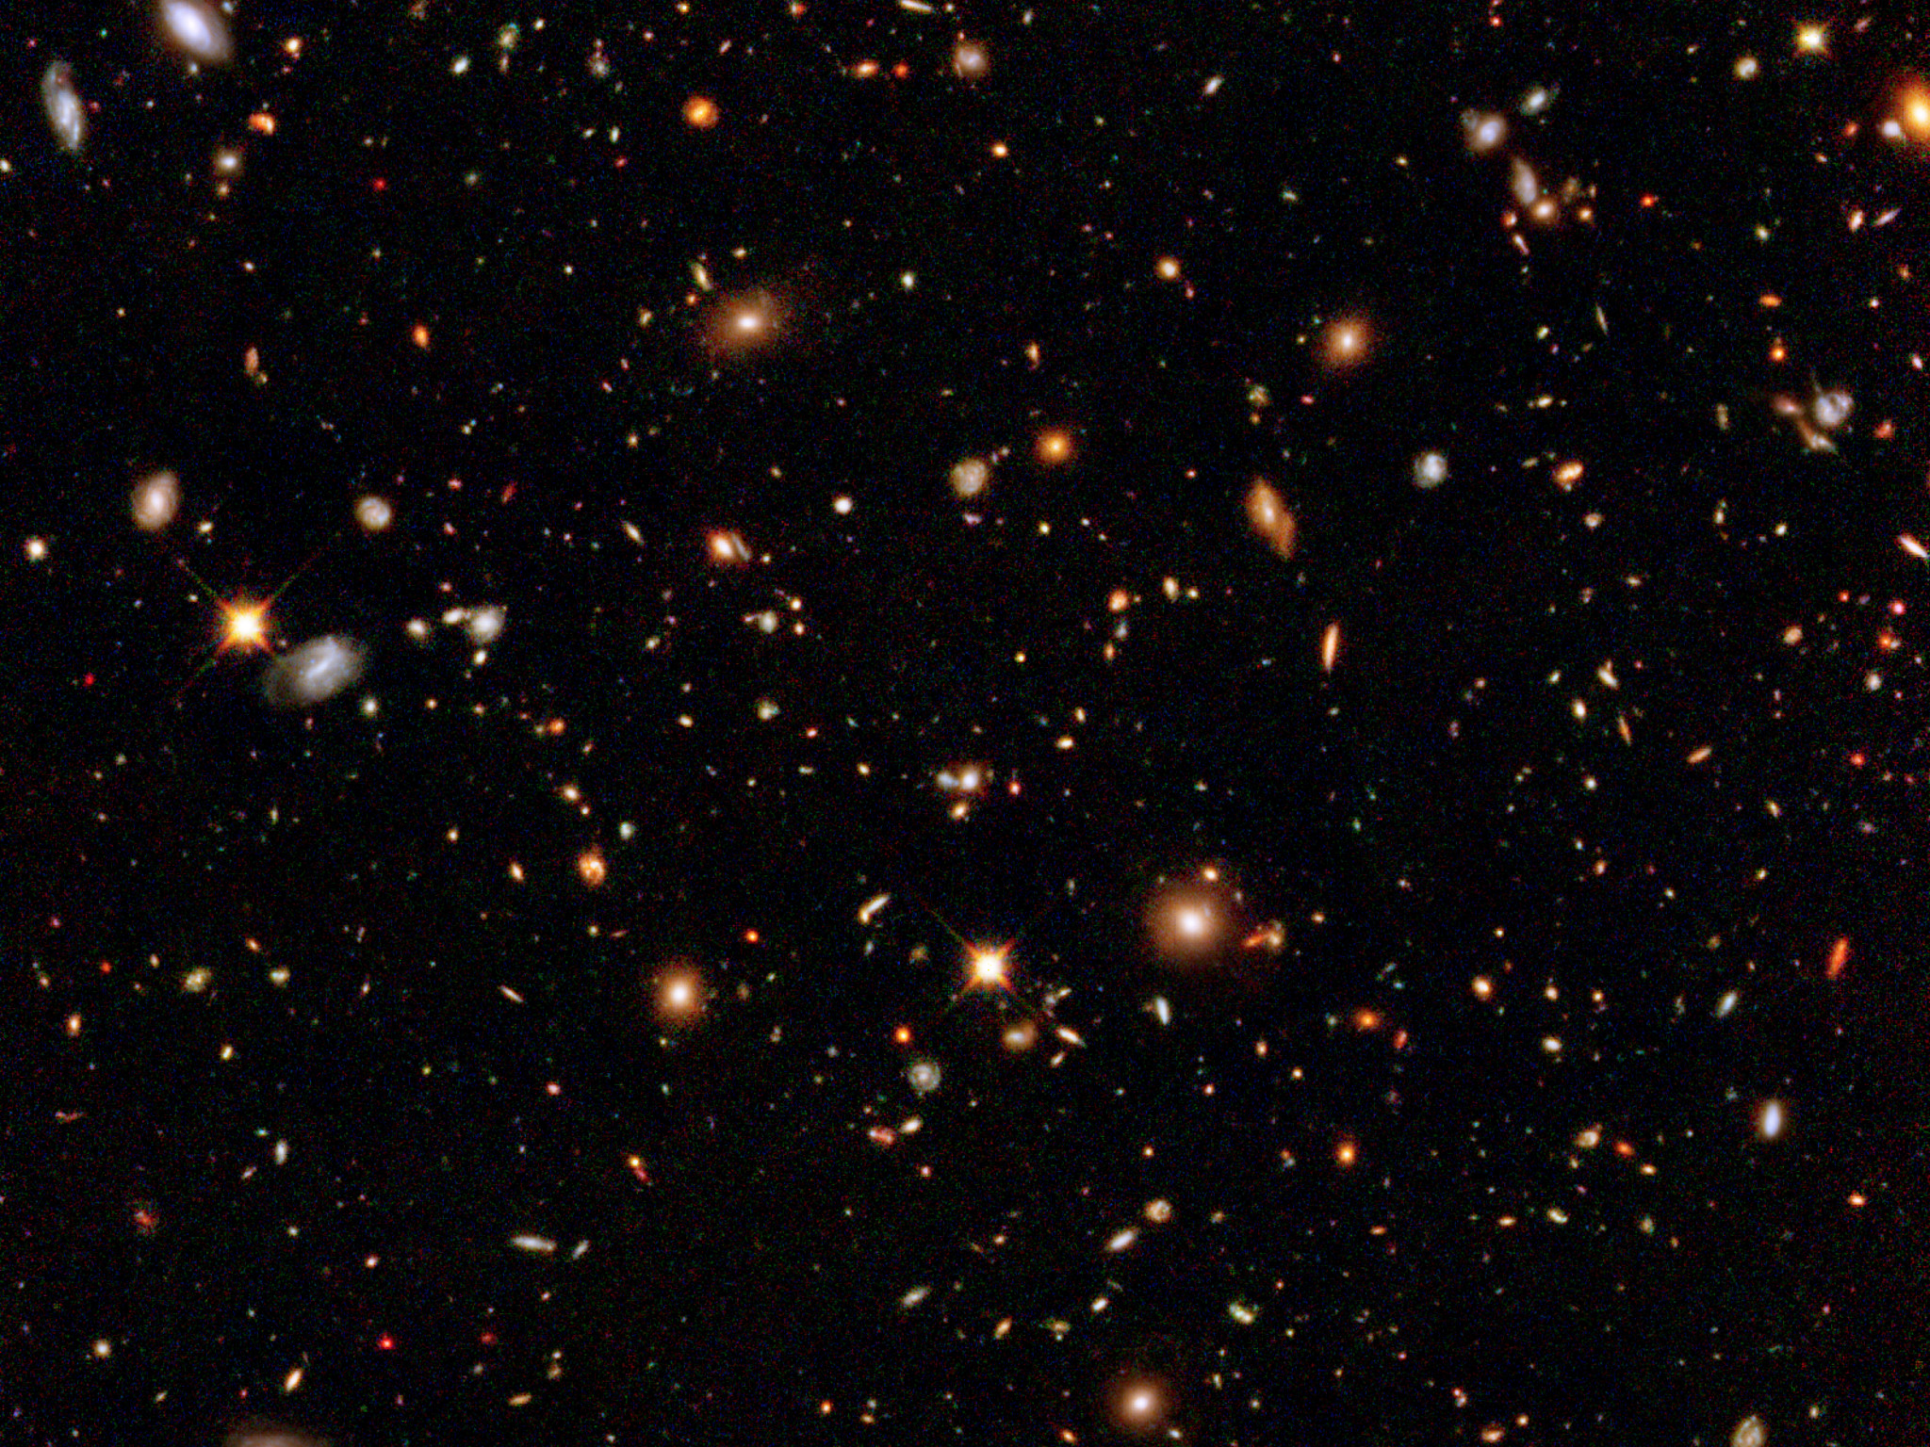


Analyzing Epoch of Reionization Quasars
Image Credit: ESA/Hubble
Victoria Jones
Dr. Matt Mechtley
Dr. Rogier Windhorst

Slide 2
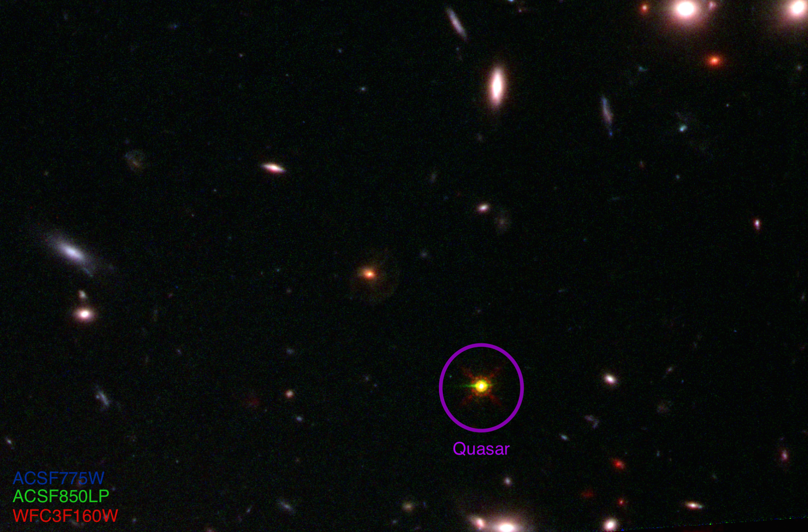
Quasars and Epoch of Reionization
What is a quasar?
What is the Epoch of Reionization?
1 billion years after Big Bang (z~6)
HST image of SDSS-J1148+5251.
Image Credit: ESA/Hubble

Slide 3
Project Outline
Explore surroundings of six dusty quasars
Study black holes at earliest epoch they can be observed
HST Wide Field Camera 3 near-IR imaging at 1.25 and 1.55 microns

Slide 4
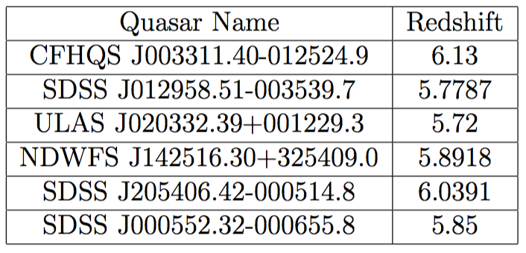
Selection Process
Six dusty quasars
Precise redshifts
Sub-millimeter detection indicated far infrared emission from dust
Needed high star formation rates
Needed relatively faint quasar point source

Slide 5
Point Source Subtraction
First Panel—image color to see contrast
Second Panel—model
Third Panel—first image of point source subtraction
Last Panel—blurred image of third panel to get rid of noise

Slide 6
Results: Compared to Other z~6 Galaxies
Average upper limit for host galaxy absolute magnitudes: M_{F160W} > -21.54
Several companions with colors and magnitudes consistent with z~6 galaxies

Slide 7
Results: Point Source Color versus Magnitude
No trend between quasar brightness and dust reddening
One outlier, both brighter and redder, with weak Lyα emission, suggests foreground screen of dust

Slide 8
Final Results and Future Work
Star Formation Rates: < 26.51-80.99
Several close companions with fluxes and colors consistent with bright z~6 galaxies
None of the hosts detected—dust in the immediate (1-2 kpc) region surrounding the black hole
Plan to observe four quasars with close companions in emitted UV/optical light using the JWST NIRSpec integral field spectrograph, beginning in 2019

Slide 9

Acknowledgements
Collaborators: Matt Mechtley, Rogier Windhorst, Rolf Jansen, Seth Cohen
Arizona/NASA Space Grant Consortium
Grant Number GO-12974.A from the Space Telescope Science Institute

